Slide 1
Process Management
Notes:
1
1
1
1

Slide 2
CONTENTS
Process Concept, Process States, Process Description
Processes and Threads
Symmetric Multiprocessing
Concurrency: Principles of Concurrency
Mutual Exclusion: S/W approaches, H/W Support
Programming Language construct: Semaphores, Monitors
Classical Problems of Synchronization: Readers-Writers problem, Producer Consumer problem, Dining Philosopher problem.
Notes:
2
2
2

Slide 3
Roadmap
Process Concept, Process States, Process Description
How are processes represented and controlled by the OS.
Process states which characterize the behaviour of processes.
Data structures used to manage processes.
Ways in which the OS uses these data structures to control process execution.
Notes:
3
3
3
3

Slide 4
Requirements of an Operating System
Fundamental Task: Process Management
The Operating System must
Interleave the execution of multiple processes
Allocate resources to processes, and protect the resources of each process from other processes,
Enable processes to share and exchange information,
Enable synchronization among processes.
The OS Manages Execution of Applications
Resources are made available to multiple applications
The processor is switched among multiple application
The processor and I/O devices can be used efficiently
Notes:
4
4
4
Explain that:
on a multiprogramming uniprocessor, the execution of multiple processes can be interleaved in time.
on a multiprocessor, not only may process execution be interleaved, but also multiple processes can execute simultaneously.
Explain that process management is compounded by the introduction of the concept of thread. In a multithreaded system,
the process retains the attributes of resource ownership,
The thread retains the attributes of multiple, concurrent execution streams running within a process.
4

Slide 5
What is a Process?
Recall from Unit 1 that a process is a program in
execution.
A process in execution needs resources like processing resource, memory and IO resource.
Imagine a program written in C – my_prog.c.
After compilation we get an executable.
If we now give a command like ./a.out it becomes a
process.
Notes:
5
5

Slide 6
Process
A program in execution
An instance of a program running on a computer
The entity that can be assigned to and executed on a processor
A unit of activity characterized by the execution of a sequence of instructions, a current state, and an associated set of system instructions
Notes:
6
6
6
6

Slide 7
Process Concept
An operating system executes a variety of programs:
Batch system – jobs
Time-shared systems – user programs or tasks
Textbook uses the terms job and process almost interchangeably
Process – a program in execution; process execution must progress in sequential fashion
process is comprised of:
Program code (possibly shared)
A set of data
A number of attributes describing the state of the process
of the process
Notes:
7
7
7
7

Slide 8
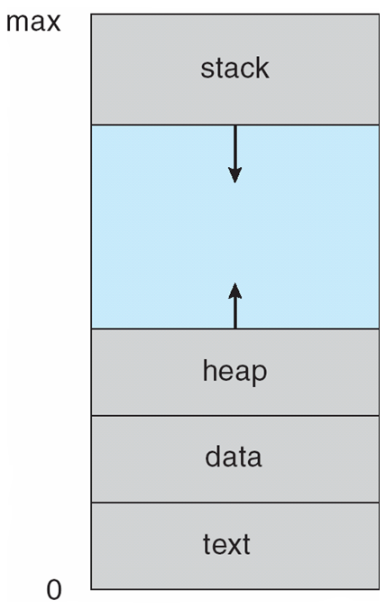
Process in Memory
Function Parameters, return address, local variables
Dynamically allocated memory for execution of program
Global variables
Program code
Notes:
8
8
8
8

Slide 9
Process Elements
While the process is running it has a number of elements including
Identifier
State
Priority
Program counter
Memory pointers
Context data
I/O status information
Accounting information
Notes:
9
9
9
9

Slide 10
Process Control Block
Contains the process elements
Created and manage by the operating system
The PCB is constructed at process creation.
PCB includes a pointer to be used in lists (queues) of PCBs.
Allows support for multiple processes
The PCB is used to save information about a process when switched out of CPU.
Notes:
10
10
10
10

Slide 11
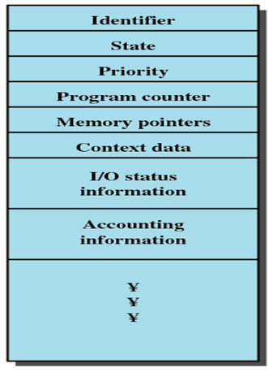
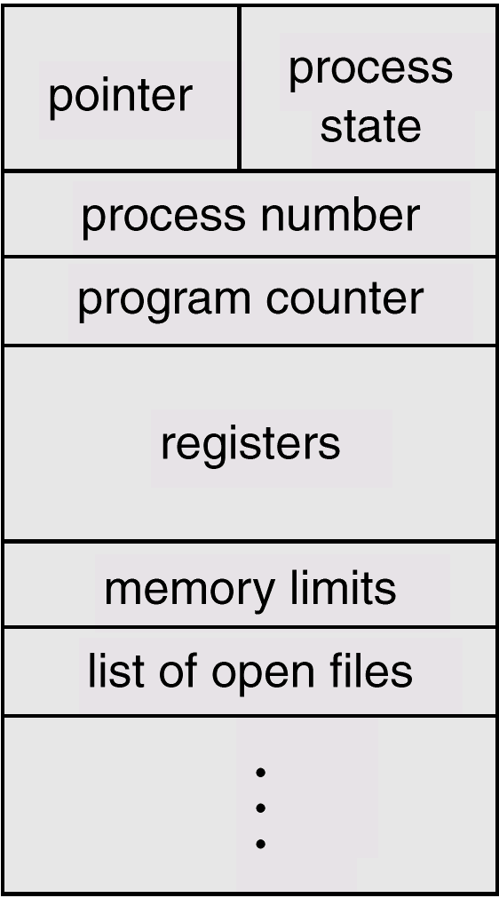
Process Control Block
Notes:
11
11
11
11

Slide 12
Process Control Block
Information associated with each process is stored in PCB.
Process state : new, running, etc.
Program counter : address of next instruction to be executed
CPU registers :E.g. accumulator, stack pointers, general purpose registers.
CPU scheduling information :Process priority, elapsed time, other scheduling parameters etc.
Memory-management information :E.g. base and limit registers, page table, segment table
Accounting information: E.g. amount of CPU & real time used, time limits, account number, etc.
I/O status information: I/O devices allocated, list of open files, etc.
Notes:
12
12
12

Slide 13
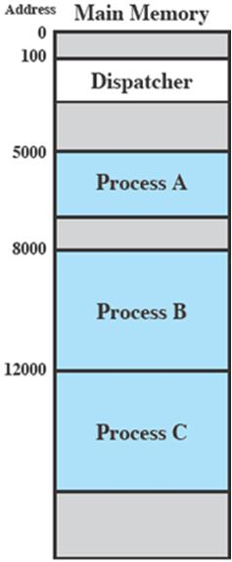
Trace of the Process
Process Execution
The behavior of an individual process is shown by listing the sequence of instructions that are executed
This list is called a Trace
Dispatcher is a small program which switches the processor from one process to another
Consider three processes being executed
All are in memory (plus the dispatcher)
Notes:
13
13
13
13

Slide 14
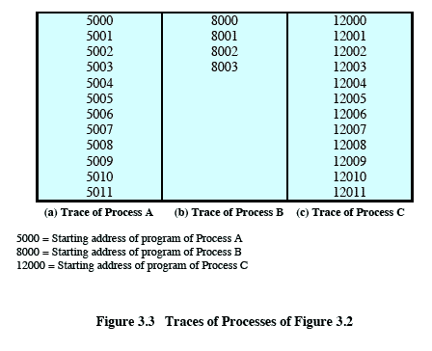
Trace from the processes point of view:
Each process runs to completion
Notes:
14
14
Animated slide
Wipes down to give impression of process progression
14

Slide 15
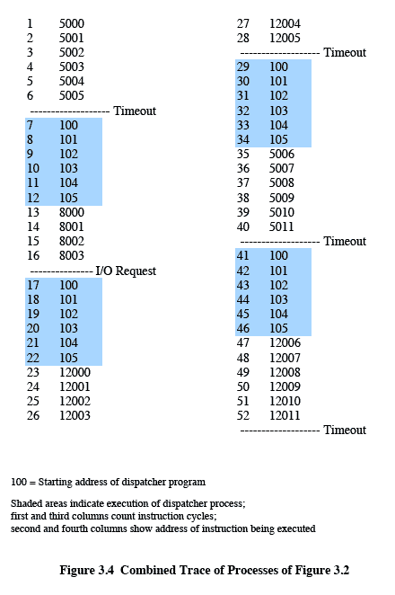
Trace from Processors point of view
Timeout
Timeout
Timeout
I/O
Notes:
15
15

Slide 16
Trace from Processors point of view
The shaded areas represent code executed by the dispatcher.
The same sequence of instructions is executed by the dispatcher in each instance because the same functionality of the dispatcher is being executed.
We assume that the OS only allows a process to continue execution for a maximum of six instruction cycles, after which it is interrupted; this prevents any single process from monopolizing processor time.
The first six instructions of process A are executed, followed by a time-out and the execution of some code in the dispatcher, which executes six instructions before turning control to process B2.
After four instructions are executed, process B requests an I/O action for which it must wait. Therefore, the processor stops executing process B and moves on, via the dispatcher, to process C.
After a time-out, the processor moves back to process A. When this process times out, process B is still waiting for the I/O operation to complete, so the dispatcher moves on to process C again
Notes:
16
16
16

Slide 17
Roadmap
Process Concept, Process States, Process Description
How are processes represented and controlled by the OS.
Process states which characterize the behaviour of processes.
Data structures used to manage processes.
Ways in which the OS uses these data structures to control process execution.
Notes:
17
17
17
Progress indicator
17

Slide 18
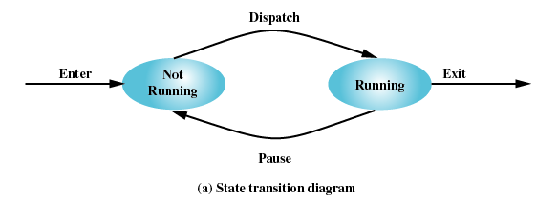
Two-State Process Model
Process may be in one of two states
Running
Not-running
Notes:
18
18
18
18

Slide 19
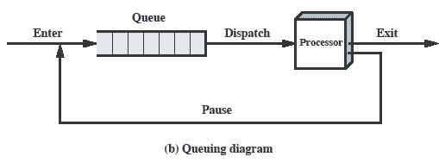
Queuing Diagram
Etc … processes moved by the dispatcher of the OS to the CPU then back to the queue until the task is competed
Notes:
19
19

Slide 20
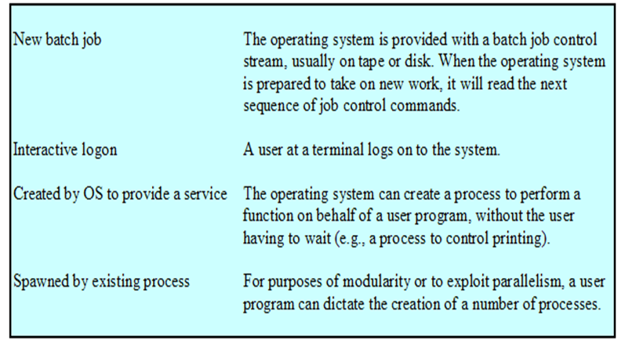
Process Creation
Notes:
20
20
20
20

Slide 21
Process Creation
The OS builds a data structure to manage the process
Traditionally, the OS created all processes
But it can be useful to let a running process create another
This action is called process spawning
Parent Process is the original, creating process
Child Process is the new process
Notes:
21
21
21
21

Slide 22
Process Termination
There must be some way that a process can indicate completion.
This indication may be:
A HALT instruction generating an interrupt alert to the OS.
A user action (e.g. log off, quitting an application)
A fault or error
Parent process terminating
Notes:
22
22
22

Slide 23
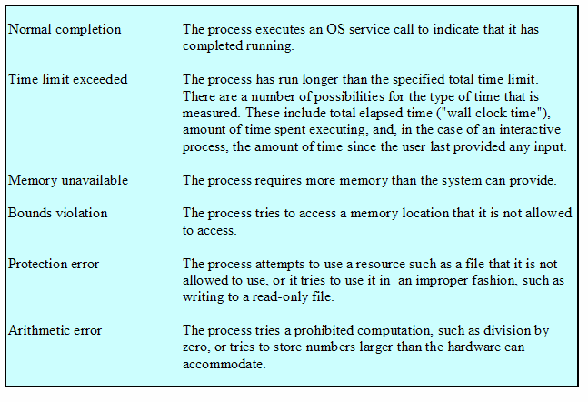
Process Termination
Notes:
23
23
23
23

Slide 24
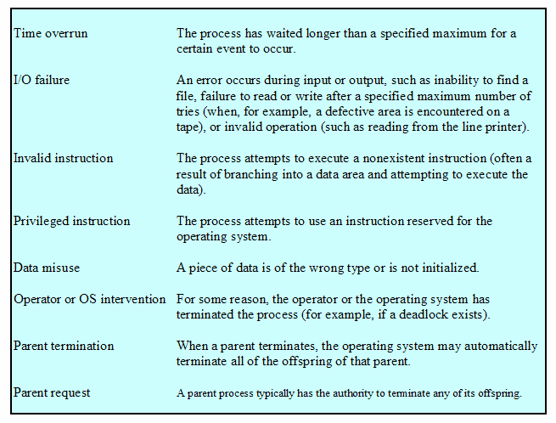
Process Termination
Notes:
24
24
24
24

Slide 25
Problems with two state model?
Are all processes that are “not running” always ready to run?
Split “Not Running” into two states!
Ready
Blocked
Vishal Kaushal
Notes:
25

Slide 26
Process states
Ready
ready to execute
Blocked
waiting for I/O
Dispatcher cannot just select the process that has been in the queue the longest because it may be blocked
Notes:
26
26
26
26

Slide 27
A Five-State Model
In all the previous examples, we said
A process is in “RUN” state if is engaging the
processor,
A process is in “WAIT” state if it is waiting for IO to be completed
In our simplistic model we may think of 5 states:
Running
Ready
Blocked
New
Exit
Notes:
27
27
27
27

Slide 28
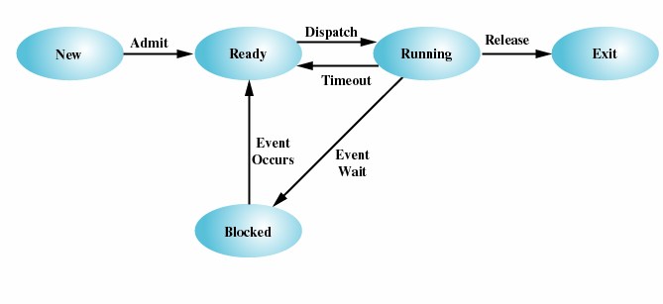
Five-State Process Model
Notes:
28
28
28
28

Slide 29
Possible transitions of Process State:
Null 🡪 New : New process is created to execute program
New 🡪 Ready : Submit the new process to ready queue
Ready 🡪 Running : Send the Ready Process to Execute
Running 🡪 Exit : After completion of Execution, exit the process
Running 🡪 Ready : In time sharing system, After time expired of process, put that process again into Ready queue
Running 🡪 Blocked : if process requesting for something (I/O), put that in
blocked queue until it get the resource
Blocked 🡪 Ready: After completing request put that process in ready queue
Ready 🡪 Exit : Parent process can terminate Child Process at any time
Blocked 🡪 Exit :If process requesting inaccessible resource.
Notes:
29
29
29
29

Slide 30
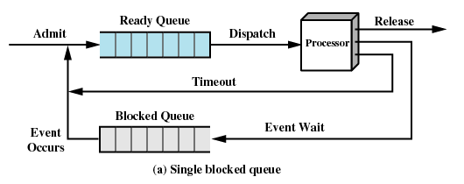
Using Two Queues
This model would require an additional queue for the blocked processes.
But when an event occurs the dispatcher would have to cycle through the entire queue to see which process is waiting for the event.
This can cause huge overhead when their may be 100’s or 1000’s of processes
Notes:
30
30
30
30

Slide 31
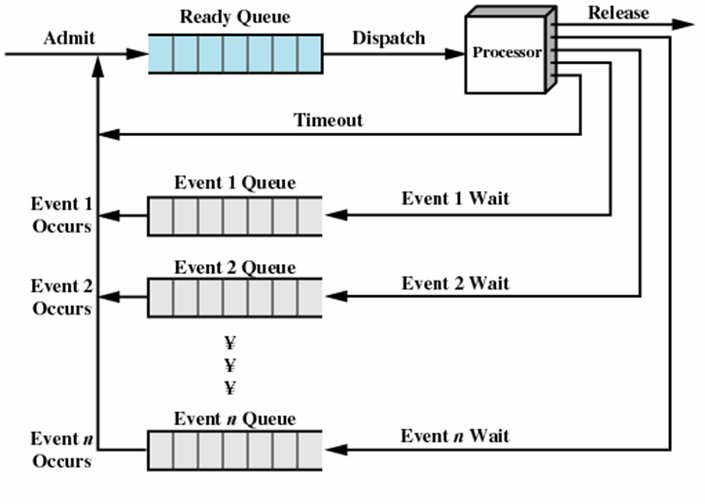
Multiple Blocked Queues
More efficient to have a separate ‘blocked’ queue for each type of event.
Notes:
31
31
31
31

Slide 32
A problem still exists!
Even with multi programming processor would be idle most of the time!
It is common for all processes in memory to be waiting for I/O soon
Solution?
Increase main memory to accommodate more processes
Two problems:
Cost
More memory need not necessarily mean more processes!
Vishal Kaushal
Notes:
32

Slide 33
Swapping
Moving part or all of a process from main memory to disk
“Part” in case of virtual memory
OS swaps one of the blocked processes out onto disk into a suspended queue
Queue of existing processes temporarily kicked out
Even with Virtual Memory this is required at times for performance reasons
OS then brings in another process from suspended queue or honors a new process request
But isn’t this also an I/O operation? Wont it make the problem worse?
Vishal Kaushal
Notes:
33

Slide 34
Suspended Processes
Processor is faster than I/O so all processes could be waiting for I/O
Swap these processes to disk to free up more memory
Blocked state becomes suspend state when swapped to disk
Two new states
Blocked/Suspend
Ready/Suspend
Notes:
34
34
34
34

Slide 35
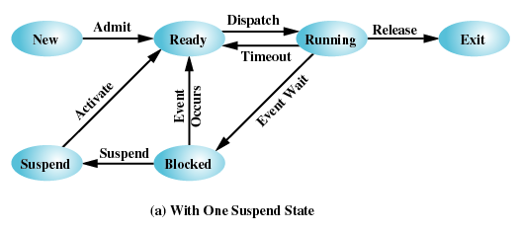
One Suspend State
Notes:
35
35
35
35

Slide 36
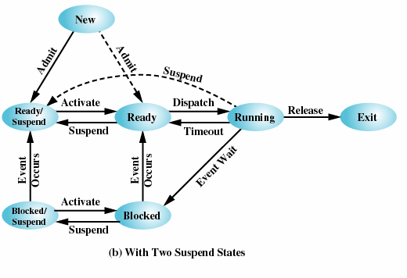
Two Suspend States
Notes:
36
36
36
36

Slide 37
Process State Transitions:
Ready: The process is in main memory and available for execution
Blocked: Process is in main memory and waiting for an event
Blocked / Suspended: The process is in secondary memory and waiting for an event
Ready / Suspended: Process is in secondary memory but is available for execution as soon as it loaded it into main memory
Notes:
37
37
37
37

Slide 38
Process State Transitions:
Blocked 🡪 Blocked/Suspend: If there are no ready processes, then at least one blocked process is swapped out to make room for another process that is not blocked. This transition can be made even if there are ready processes available, if the OS determines that the currently running process or a ready process that it would like to dispatch requires more main memory to maintain adequate performance.
Blocked/Suspend 🡪 Ready/Suspend: A process in the Blocked/Suspend state is moved to the Ready/Suspend state when the event for which it has been waiting occurs.
Ready/Suspend 🡪 Ready: When there are no ready processes in main memory, or if a suspended process has a higher priority, the OS will need to bring one in to continue execution.
Ready 🡪 Ready/Suspend: Normally, the OS would prefer to suspend a blocked process rather than a ready one, because the ready process can now be executed, whereas the blocked process is taking up main memory space and cannot be executed. However, it may be necessary to suspend a ready process if that is the only way to free up a sufficiently large block of main memory.
Notes:
38
38
38

Slide 39
Process State Transitions:
New 🡪 Ready/Suspend and New 🡪Ready: When a new process is created, it can either be added to the Ready queue or the Ready/Suspend queue.
In either case, the OS must create a process control block and allocate an address space to the process.There would often be insufficient room in main memory for a new process; hence the use of the (New 🡪 Ready/Suspend) transition.
Blocked/Suspend 🡪 Blocked: Inclusion of this transition may seem to be poor design. After all, if a process is not ready to execute and is not already in main memory, what is the point of bringing it in? But consider the following scenario:
A process terminates, freeing up some main memory.
There is a process in the (Blocked/Suspend) queue with a higher priority than any of the processes in the (Ready/Suspend) queue and
the OS has reason to believe that the blocking event for that process will occur soon.
Under these circumstances, it would seem reasonable to bring a blocked process into main memory in preference to a ready process.
Notes:
39
39
39

Slide 40
Process State Transitions:
Running 🡪 Ready/Suspend: Normally, a running process is moved to the Ready state when its time allocation expires. If, however, the OS is pre-empting the process because a higher-priority process on the Blocked/Suspend queue has just become unblocked, the OS could move the running process directly to the (Ready/Suspend) queue and free some main memory.
Any State 🡪 Exit: Typically, a process terminates while it is running, either because it has completed or because of some fatal fault condition. However, in some operating systems, a process may be terminated by the process that created it or when the parent process is itself terminated. If this is allowed, then a process in any state can be moved to the Exit state.
Notes:
40
40
40

Slide 41
Characteristics of Suspended process
The process in not immediately available for execution
The process may or may not be waiting on an event.
The process was placed in a suspended state by an agent: either itself, a parent process or OS ,for preventing its execution.
The process may not be removed from this state until the agent explicitly orders the removal.
Notes:
41
41
41

Slide 42
Reasons for Process Suspension
Reason | Comment
Swapping | The OS needs to release sufficient main memory to bring in a process that is ready to execute.
Other OS Reason | OS suspects process of causing a problem.
Interactive User Request | e.g. debugging or in connection with the use of a resource.
Timing | A process may be executed periodically (e.g. an accounting or system monitoring process) and may be suspended while waiting for the next time.
Parent Process Request | A parent process may wish to suspend execution of a descendent to examine or modify the suspended process, or to coordinate the activity of various descendants.
Notes:
42
42
42

Slide 43
Roadmap
Process Concept, Process States, Process Description
How are processes represented and controlled by the OS.
Process states which characterize the behaviour of processes.
Data structures used to manage processes.
Ways in which the OS uses these data structures to control process execution.
Notes:
43
43
43

Slide 44
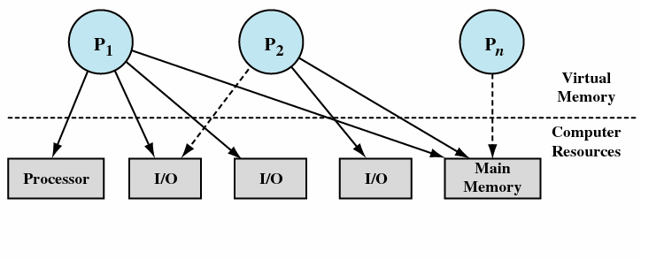
Process Description: Processes and Resources
Operating systems are considered as a manager of the underneath various hardware resources.
operating system is an entity that manages the use of system resources by processes
Waiting for resource
Notes:
44
44
44
44

Slide 45
Process Description: Processes and Resources
There are a number of processes (P1, . . ., Pn,) that have been created and exist in virtual memory.
Each process, during the course of its execution, needs access to certain system resources, including the processor, I/O devices, and main memory.
In the figure, process P1 is running; at least part of the process is in main memory, and it has control of two I/O devices.
Process P2 is also in main memory but is blocked waiting for an I/O device allocated to P1.
Process Pn has been swapped out and is therefore suspended.
Notes:
45
45
45

Slide 46
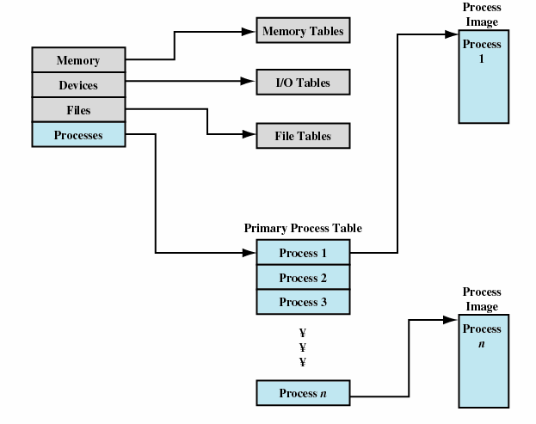
Operating system control tables
OS has to manage processes and resources, it must have information about the current status of each process and resource.
Tables are constructed for each entity, the operating system manages.
Notes:
46
46
46
46

Slide 47
Control structures
1. Memory tables: are used to keep track of both main memory and secondary memory.
- Part of main memory is reserved for use by the operating system;
The memory tables generally include the following information:
– the allocation of main memory to processes
– the allocation of secondary memory to processes
– protection attributes of blocks of main or virtual memory
2. I/O tables: are used by the operating system to manage I/O devices. They should record:
– the availability of each particular device
– the status of I/O operations relating to each device
- the location in main memory being used as the source or destination of the I/O transfer.
Notes:
47
47
47
47

Slide 48
Control structures
3. File tables: provides information about
– Existence of files
-Location on secondary memory
-Current Status
-Attributes
-Sometimes this information is maintained by a file management system
4. Process table :
- To manage processes the OS needs to know details of the processes
Current state
Process ID
Location in memory
etc
Process control block
Process image is the collection of program,Data, stack, and attributes
Notes:
48
48
48
48

Slide 49
Process Control Structure/Process Image
Elements of Process Image:
User Data: Modifiable part of user space;
- Includes program data, user stack area and programs that may be modified
User Program: the program to be executed
System Stack: each process have 1/more system stacks;
- Used to store parameters and calling address for system calls
Process Control Block: data needed by OS to control the process
We can group the process control block information into three general categories:
Process identification
Processor state information
Process control information
Notes:
49
49
49
49

Slide 50
Elements of a PCB
Process Identifier:
Identifier of this process
Identifier of the process that created this process (parent process)
User identifier
Processor state information:
User Visible register
Control and stack register
Stack pointer
Program status word (PSW) - contains status information
Process control information:
Scheduling and state Information
Data Structuring
Interprocess communication
Memory Management
Resource Ownership and Utilization
Notes:
50
50
50
50

Slide 51
Roadmap
Process Concept, Process States, Process Description
How are processes represented and controlled by the OS.
Process states which characterize the behaviour of processes.
Data structures used to manage processes.
Ways in which the OS uses these data structures to control process execution.
Notes:
51
51
51
Progress indicator
51

Slide 52
Modes of Execution
Most processors support at least two modes of execution
User mode
Less-privileged mode
User programs typically execute in this mode
System mode:also known as
Control Mode/ Kernel Mode / Protected Mode
More-privileged mode
Kernel of the operating system
Notes:
52
52
52

Slide 53
Process Control
Mode of Execution: Dual-mode operation allows OS to protect itself and other system components
How does the processor know in which mode it is to be executing? And how does it change
Mode bit provided by hardware (there is a bit in PSW that indicates the mode of execution)
Provides ability to distinguish when system is running user code or kernel code
Some instructions designated as privileged, only executable in kernel mode
System call changes mode to kernel, return from call resets it to user
Notes:
53
53
53
53

Slide 54
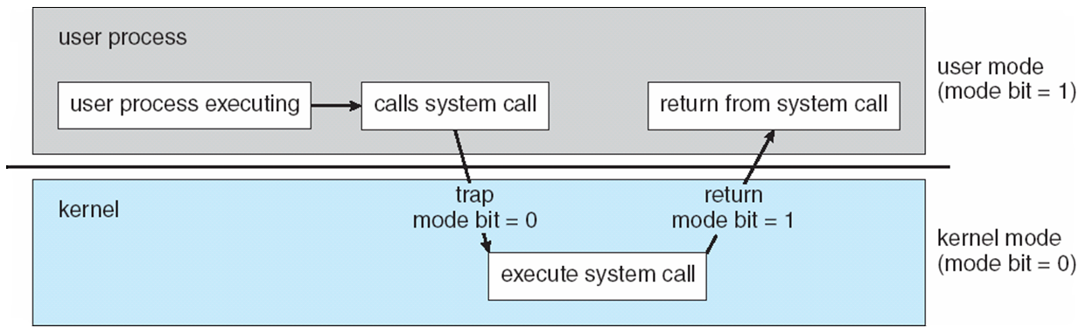
Transition from User to Kernel Mode
Timer to prevent infinite loop / process hogging resources
Set interrupt after specific period
Operating system decrements counter
When counter becomes zero generate an interrupt
Set up before scheduling process to regain control or terminate program that exceeds allotted time
Notes:
54
54
54
54

Slide 55
Process Creation
Once the OS decides to create a new process it:
Assign a unique process identifier
Allocate space for the process
Initialize process control block
Set up appropriate linkages
Ex: add new process to linked list used for scheduling queue
Create / expand other data structures
Ex: maintain an accounting file
Notes:
55
55
55
55

Slide 56
Switching Processes
Several design issues are raised regarding process switching
What events trigger a process switch?
We must distinguish between mode switching and process switching.
What must the OS do to the various data structures under its control to achieve a process switch?
Notes:
56
56
56

Slide 57
When to switch processes
A process switch may occur any time that the OS has gained control from the currently running process. Possible events giving OS control are:
Mechanism | Cause | Use
Interrupt | External to the execution of the current instruction | Reaction to an asynchronous external event
Trap | Associated with the execution of the current instruction | Handling of an error or an exception condition
Supervisor call | Explicit request | Call to an operating system function
Table : Mechanisms for Interrupting the Execution of a Process
Notes:
57
57
57
A process switch may occur any time that the OS has gained control from the currently running process.
Table 3.8 suggests the possible events that may give control to the OS.
Two kinds of system interrupts,
one is simply called an interrupt,
and the other called a trap.
“interrupts” are due to some sort of event that is external to and independent of the currently running process, such as the completion of an I/O operation.
With an ordinary interrupt, control is first transferred to an interrupt handler, which does some basic housekeeping and then branches to an OS routine that is concerned with
the particular type of interrupt that has occurred.
“Traps” relate to an error or exception condition generated within the currently running process, such as an illegal file access attempt.
With traps, the OS determines if the error or exception condition is fatal.
If so, then the currently running process is moved to the Exit state and a process switch occurs.
If not, then the action of the OS will depend on the nature of the error and the design of the OS.
It may attempt some recovery procedure or simply notify the user.
It may do a process switch or resume the currently running process.
Finally, the OS may be activated by a supervisor call from the program being executed.
For example, a user process is running and an instruction is executed that requests an I/O operation, such as a file open.
This call results in a transfer to a routine that is part of the operating system code. The use of a system call may place the user process in the Blocked state.
57

Slide 58
When to switch processes
Two kinds of system interrupts,
one is simply called an interrupt,
and the other called a trap.
“interrupts” are due to some sort of event that is external to and independent of the currently running process, such as the completion of an I/O operation.
With an ordinary interrupt, control is first transferred to an interrupt handler, which does some basic housekeeping and then branches to an OS routine that is concerned with the particular type of interrupt that has occurred.
With traps, the OS determines if the error or exception condition is fatal.
If so, then the currently running process is moved to the Exit state and a process switch occurs.
If not, then the action of the OS will depend on the nature of the error and the design of the OS.
It may attempt some recovery procedure or simply notify the user.
It may do a process switch or resume the currently running process.
Notes:
58
58
58
58

Slide 59
When to switch processes
the OS may be activated by a supervisor call from the program being executed.
For example, a user process is running and an instruction is executed that requests an I/O operation, such as a file open.
This call results in a transfer to a routine that is part of the operating system code.
The use of a system call may place the user process in the Blocked state
Notes:
59
59
59

Slide 60
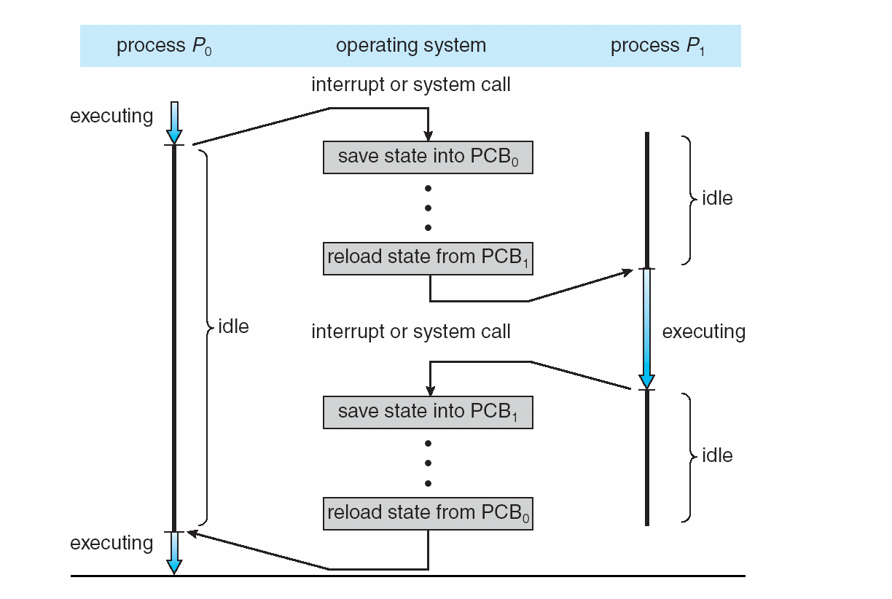
CPU Switch From Process to Process
Notes:
60
60
60
60

Slide 61
Process Switching (Cont)
Mode of switching:
Save the context of the current program being executed
Set the program counter to the starting address of an interrupt-handler program
Switch from user mode to kernel mode so that interrupt processing code may include privileged instructions
Notes:
61
61
61
61

Slide 62
Change process state:
If the currently running process is to be moved to another state (Ready, Blocked, etc.), then the OS must make substantial changes in its environment.
Steps involved in process switching:
Save the context of the processor including program counter and other register.
Update the PCB of the process that is currently in the Running state
Move PCB to appropriate queue – ready; blocked; ready/suspend
Select another process for execution
Update PCB of selected process
Update memory management data structure
Restore context of the processor
Notes:
62
62
62
62

Slide 63
CONTENTS
Process Concept, Process States, Process Description
Processes and Threads
Symmetric Multiprocessing, Microkernel
Concurrency: Principles of Concurrency
Mutual Exclusion: S/W approaches, H/W Support
Programming Language construct: Semaphores, Monitors
Classical Problems of Synchronization: Readers-Writers problem, Producer Consumer problem, Dining Philosopher problem.
Notes:
63
63
63
63

Slide 64
Principles of concurrency,
Mutual exclusion
Operating Systems :
Internals and Design Principles William Stallings
Notes:
64
64
64

Slide 65
Concurrency
Multi-programming:
- Management of multiple processes within a uniprocessor system, every system has this support, whether big, small or complex.
Multi-processing:
- Management of multiple processes within a multi-processor system, servers and works stations. (Shared Memory)
Distributed Processing:
Management of multiple processes executing on number of distributed computer systems, for example clusters. (Do not Share Memory)
Concurrency: Execution of multiple processes no matter on single or more processing elements.
One thing is common among all these categories?
Notes:
65
65
65

Slide 66
Principles of Concurrency
Interleaving:
In a single processor case, multiple processes are interleaved in time to provide the illusion of simultaneous execution of these processes.
Although, it is not really parallel processing but there are benefits using such technique, apart from having overheads involved in switching of these processes.
Notes:
66
66
66

Slide 67
Concurrency
Concurrency arises in:
Multiple applications
Sharing time
Structured applications
Extension of modular design
Operating system structure
OS themselves implemented as a set of processes or threads
Notes:
67
67
67
• Multiple applications:
Multiprogramming was invented to allow processing time to be dynamically shared among a number of active applications.
• Structured applications:
As an extension of the principles of modular design and structured programming, some applications can be effectively programmed as a set of concurrent processes.
• Operating system structure:
The same structuring advantages apply to systems programs, and we have seen that operating systems are themselves often implemented as a set of processes or threads.
67

Slide 68
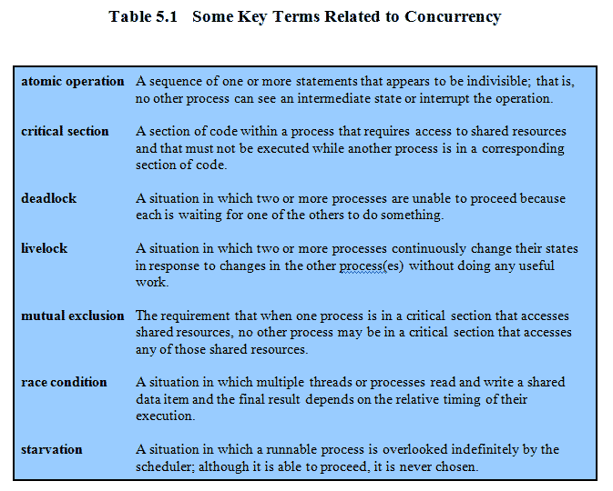
Key Terms
Notes:
68
68
68
These terms will be explained throughout this chapter – do not labor this table.
It may be best skipped over and given as a reference point for students.
68

Slide 69
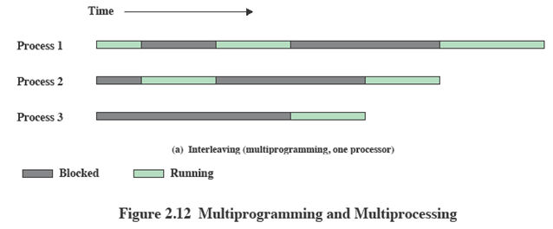
Interleaving and Overlapping Processes
Earlier we saw that processes may be interleaved on uniprocessors
Notes:
69
69
69

Slide 70
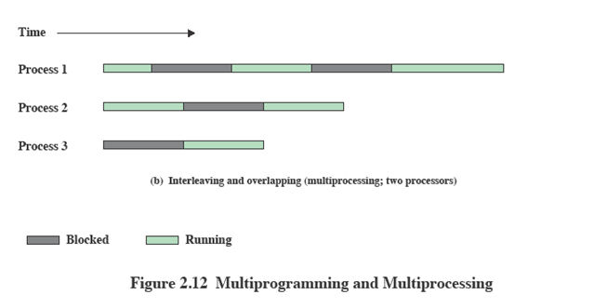
Interleaving and Overlapping Processes
And not only interleaved but overlapped on multi-processors
Notes:
70
70
70

Slide 71
Difficulties of Concurrency
Sharing of global resources:
If two processes both make use of the same global variable and both perform reads and writes on that variable, then the order in which the various reads and writes are executed is critical.
Optimally managing the allocation of resources:
It is difficult for the OS to manage the allocation of resources optimally.
e.g. A process may request use of, and be granted control of, a particular I/O channel and then be suspended before using that channel.
It may be undesirable for the OS simply to lock the channel and prevent its use by other processes;
indeed this may lead to a deadlock condition,
Difficult to locate programming errors as results are not deterministic and reproducible.
Notes:
71
71
71
71

Slide 72
Principles of Concurrency
Suppose we have two or more applications reading input from the keyboard and put the result on the screen.
function_test ( )
{
Chin=getchar();
Chout=chin;
Putchar(chout)
}
A program that will provide a character
input is obtained from a keyboard one keystroke at a time.
Each input character is stored in variable chin.
It is then transferred to variable chout
and finally sent to the display.
Now consider that we have a single-processor multiprogramming system supporting a single user.
The user can jump from one application to another, and each application uses the same keyboard for input and the same screen for output.
Notes:
72
72
72

Slide 73
A Simple Example: On a uniprocessor,multiprogramming
P2
Process P2 has called function_test and
allowed to run till end with input “Y”,
P1
Process P1 has called function_test and
have just read (X) the input and being
interrupted,
so chin = X;
P1
P1 resumed, it will display what ?
the character input to P1 is lost
Notes:
73
73
73

Slide 74
Principles of Concurrency
So the first ”chout” is lost, what can we do to prevent such problem (which is called mutual exclusion),
The above example is for uniprocessor system, but similar problem can occur on a Multi-processor platform while sharing of resources.
e.g. accessing the same location (variable) by two or more processes running on different machines.
Process p1
…
Chin=getchar();
…
Chout=chin;
Putchar(chout)
..
..
Process P2
…
..
Chin=getchar();
Chout=chin;
….
…..
Putchar( chout)
Notes:
74
74
74

Slide 75
Enforce Single Access
If we enforce a rule that only one process may enter the function at a time then:
P1 & P2 run on separate processors
P1 enters function_test() first,
P2 tries to enter but is blocked – P2 suspends
P1 completes execution
P2 resumes and executes function_test()
Notes:
75
75
75
Processes P1 and P2 are both executing, each on a separate processor.
P1 invokes the test procedure.
2. While P1 is inside the test procedure, P2 invokes test.
Because P1 is still inside the test procedure (whether P1 is suspended or executing), P2 is blocked from entering the procedure.
Therefore, P2 is suspended awaiting the availability of the test procedure.
3. At a later time, process P1 completes execution of test, exits that procedure, and continues executing.
Immediately upon the exit of P1 from test, P2 is resumed and begins executing test.
75

Slide 76
Race Condition
When two/more processes are reading/writing some shared data and the final result depends on who runs precisely when.
Consider P1 & P2 processes sharing same variable ‘a’ .
P3 & P4 have b & c with values b=1 & c=2
P3 executes the statement b=b+c
P4 executes the statement c=b+c
Two processes update different variables & final value depend on the order execution of two processes P3 & P4.
If P3 executes before P4 then b=3,c=5
If P4 executes before P3 then b=4,c=3
Notes:
76
76
76

Slide 77

Race Condition
Occurs when multiple processes or threads read and write data items
The final result depends on the order of execution
the “loser” of the race is the process that updates last and will determine the final value of the variable
Notes:
A race condition occurs when multiple processes or threads read and write data items so that the final result depends on the order of execution of instructions in the multiple processes. Let us consider two simple examples.
As a first example, suppose that two processes, P1 and P2, share the global variable a . At some point in its execution, P1 updates a to the value 1, and at some point in its execution, P2 updates a to the value 2. Thus, the two tasks are in a race to write variable a . In this example, the “loser” of the race (the process that updates last) determines the final value of a .
For our second example, consider two process, P3 and P4, that share global variables b and c , with initial values b = 1 and c = 2 . At some point in its execution, P3 executes the assignment b = b + c , and at some point in its execution, P4 executes the assignment c = b + c . Note that the two processes update different variables. However, the final values of the two variables depend on the order in which the two processes execute these two assignments. If P3 executes its assignment statement first, then the final values are b = 3 and c = 5 . If P4 executes its assignment statement first, then the final values are b = 4 and c = 3 .
Appendix A includes a discussion of race conditions using semaphores as an example.
77

Slide 78
Operating system concerns
Design and management issues raised by the existence of concurrency:
O/S must keep track of all the processes (normally it is done through PCB’s)
O/S must allocate and deallocate the resources for the processes. Which includes processor time, memory, files and i/o devices.
Protection of resources again unintended interference from other processes.
The results of a process must be independent of the speed at which the execution is taking place relative to the speed of other concurrent processes.
Notes:
78
78
78

Slide 79
Process Interaction
Competition among processes: Mutual exclusion, deadlock, starvation
Cooperation among processes by sharing: shared variables ,files ,databases
- Access to data item-read/write
Writing must be mutually exclusive
Need to maintain data integrity
3. Cooperation among processes by communication: send ,receive message primitives-synchronization
- No sharing of data/resources b/n processes
Notes:
79

Slide 80

Resource Competition
Concurrent processes come into conflict when they are competing for use of the same resource
for example: I/O devices, memory, processor time, clock
In the case of competing processes three control problems must be faced:
the need for mutual exclusion
deadlock
starvation
Notes:
Concurrent processes come into conflict with each other when they are competing for the use of the same resource. In its pure form, we can describe the situation as follows. Two or more processes need to access a resource during the course of their execution. Each process is unaware of the existence of other processes, and each is to be unaffected by the execution of the other processes. It follows from this that each process should leave the state of any resource that it uses unaffected. Examples of resources include I/O devices, memory, processor time, and the clock.
There is no exchange of information between the competing processes. However, the execution of one process may affect the behavior of competing processes. In particular, if two processes both wish access to a single resource, then one process will be allocated that resource by the OS, and the other will have to wait. Therefore, the process that is denied access will be slowed down. In an extreme case, the blocked process may never get access to the resource and hence will never terminate successfully.
In the case of competing processes three control problems must be faced. First is the need for mutual exclusion . Suppose two or more processes require access to a single non-sharable resource, such as a printer. During the course of execution, each process will be sending commands to the I/O device, receiving status information, sending data, and/or receiving data. We will refer to such a resource as a critical resource , and the portion of the program that uses it as a critical section of the program. It is important that only one program at a time be allowed in its critical section. We cannot simply rely on the OS to understand and enforce this restriction because the detailed requirements may not be obvious. In the case of the printer, for example, we want any individual process to have control of the printer while it prints an entire file. Otherwise, lines from competing processes will be interleaved.
The enforcement of mutual exclusion creates two additional control problems. One is that of deadlock . For example, consider two processes, P1 and P2, and two resources, R1 and R2. Suppose that each process needs access to both resources to perform part of its function. Then it is possible to have the following situation: the OS assigns R1 to P2, and R2 to P1. Each process is waiting for one of the two resources. Neither will release the resource that it already owns until it has acquired the other resource and performed the function requiring both resources. The two processes are deadlocked.
A final control problem is starvation . Suppose that three processes (P1, P2, P3) each require periodic access to resource R. Consider the situation in which P1 is in possession of the resource, and both P2 and P3 are delayed, waiting for that resource. When P1 exits its critical section, either P2 or P3 should be allowed access to R. Assume that the OS grants access to P3 and that P1 again requires access before P3 completes its critical section. If the OS grants access to P1 after P3 has finished, and subsequently alternately grants access to P1 and P3, then P2 may indefinitely be denied access to the resource, even though there is no deadlock situation.
80

Slide 81
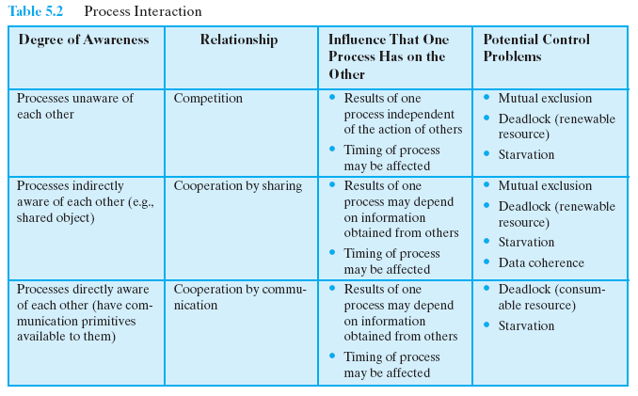
Process Interaction
multiprogramming of multiple independent processes.
Notes:
81
81
81

Slide 82

Conditions for Mutual Exclusion
Necessary conditions to provide mutual exclusion
No two processes simultaneously in critical region
No assumptions made about speeds or numbers of CPUs
No process running outside its critical region may block another process
No process must wait forever to enter its critical region
A process remains inside its critical section for a finite time only
No deadlock or starvation
Notes:
82
82
82

Slide 83
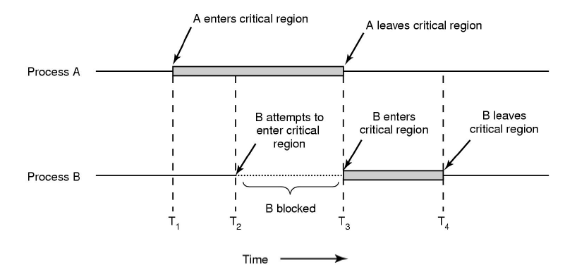
How to achieve mutual exclusion
Notes:
83
83
83

Slide 84
CONTENTS
Process Concept, Process States, Process Description
Processes and Threads
Symmetric Multiprocessing, Microkernel
Concurrency: Principles of Concurrency
Mutual Exclusion: S/W approaches, H/W Support
Programming Language construct: Semaphores, Monitors
Classical Problems of Synchronization: Readers-Writers problem, Producer Consumer problem, Dining Philosopher problem.
Notes:
84
84
84
84

Slide 85
Disabling Interrupts
S/w approach(Dekkers’s and Peterson’s lgorithm) : high processing overhead & risk of logical errors
Uniprocessors allow interleaving not overlapped execution
To guarantee mutual exclusion, it is sufficient to prevent a process from being interrupted.
Interrupt Disabling
A process runs until it invokes an operating system service or until it is interrupted
Disabling interrupts guarantees mutual exclusion
Critical section can not be interrupted
Notes:
85
85
85
In a uniprocessor system, concurrent processes cannot have overlapped execution;
they can only be interleaved.
To guarantee mutual exclusion, it is sufficient to prevent a process from being interrupted.
85

Slide 86
Pseudo-Code
while (true) {
/* disable interrupts */;
/* critical section */;
/* enable interrupts */;
/* remainder */;
}
The price of this approach, however, is high.
The efficiency of execution could be degraded because the processor is limited in its ability to interleave processes.
Notes:
86
86
86
Because the critical section cannot be interrupted, mutual exclusion is guaranteed.
The price of this approach, however, is high.
The efficiency of execution could be noticeably degraded because the processor is limited in its ability to interleave processes.
86

Slide 87
Disabling Interrupts
Disadvantages:
the efficiency of execution could be noticeably degraded
this approach will not work in a multiprocessor
architecture
Notes:
In a uniprocessor system, concurrent processes cannot have overlapped execution;
they can only be interleaved. Furthermore, a process will continue to run until it
invokes an OS service or until it is interrupted. Therefore, to guarantee mutual exclusion,
it is sufficient to prevent a process from being interrupted. This capability
can be provided in the form of primitives defined by the OS kernel for disabling and
enabling interrupts.
Because the critical section cannot be interrupted, mutual exclusion is guaranteed.
The price of this approach, however, is high. The efficiency of execution could
be noticeably degraded because the processor is limited in its ability to interleave
processes. Another problem is that this approach will not work in a multiprocessor
architecture. When the computer includes more than one processor, it is possible (and
typical) for more than one process to be executing at a time. In this case, disabled
interrupts do not guarantee mutual exclusion.
87

Slide 88
Special Machine Instructions
In multiprocessor, several processors share access to a common main memory.
Processes behave independently in a peer relationship
No interrupt mechanism b/n processors
M/c instructions are atomic
Notes:
88
88
88
88

Slide 89
Special Machine Instructions
At h/w level ,access to memory location excludes any other access to the same location.
With this foundation we have different m/c instructions .
Two types
Compare & Swap Instruction
Exchange Instruction
Notes:
89

Slide 90

Special Machine Instructions
Compare & Swap Instruction
also called a “compare and exchange instruction”
a compare is made between a memory value and a test value
if the values are the same a swap occurs
carried out atomically
Notes:
This version of the instruction checks a memory location ( *word ) against a test value ( testval ). If the memory location’s current value is testval, it is replaced with newval ; otherwise it is left unchanged. The old memory value is always returned; thus, the memory location has been updated if the returned value is the same as the test value. This atomic instruction therefore has two parts: A compare is made between a memory value and a test value; if the values are the same, a swap occurs. The entire compare&swap function is carried out atomically—that is, it is not subject to interruption.
Another version of this instruction returns a Boolean value: true if the swap occurred; false otherwise. Some version of this instruction is available on nearly all processor families (x86, IA64, sparc, IBM z series, etc.), and most operating systems use this instruction for support of concurrency.
90

Slide 91
Compare & Swap Instruction
int compare_and_swap (int *word,
int testval, int newval)
{
int oldval;
oldval = *word;
if (oldval == testval) *word = newval;
return oldval;
}
Notes:
91
91
91
This version of the instruction checks a memory location (*word) against a test value (testval).
If the memory location’s current value is testval, it is replaced with newval;
otherwise it is left unchanged.
The old memory value is always returned;
thus, the memory location has been updated if the returned value is the same as the test value.
A compare is made between a memory value and a test value;
if the values differ a swap occurs.
The entire compare&swap function is carried out atomically;
Ie it is not subject
to interruption.
91

Slide 92
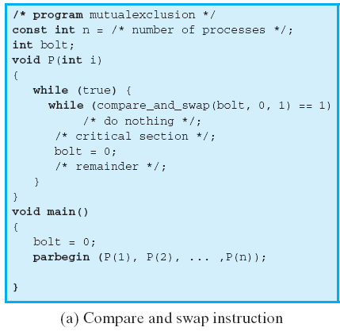
Compare & Swap Instruction
Notes:
92
92
92
This shows a mutual exclusion protocol based on the use of this instruction.
A shared variable bolt is initialized to 0.
The only process that may enter its critical section is one that finds bolt equal to 0.
All other processes that enter their critical section go into a busy waiting mode.
92

Slide 93
Exchange Instruction
void exchange(int register, int memory)
{
int temp;
temp=memory;
memory=register;
register=temp;
}
Notes:
93

Slide 94

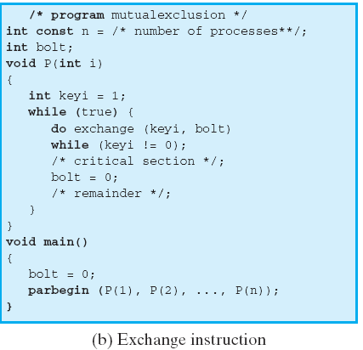
Exchange Instruction
Notes:
94
94
94
This shows a mutual exclusion protocol based on the use of an exchange instruction.
A shared variable bolt is initialized to 0.
Each process uses a local variable key that is initialized to 1.
The only process that may enter its critical section is one that finds bolt equal to 0.
It excludes all other processes from the critical section by setting bolt to 1.
When a process leaves its critical section, it resets bolt to 0, allowing another process to gain access to its critical section.
94

Slide 95

Special Machine Instruction:
Advantages
Applicable to any number of processes on either a single processor or multiple processors sharing main memory
Simple and easy to verify
It can be used to support multiple critical sections; each critical section can be defined by its own variable
Notes:
The use of a special machine instruction to enforce mutual exclusion has a number of advantages:
• It is applicable to any number of processes on either a single processor or multiple processors sharing main memory.
• It is simple and therefore easy to verify.
• It can be used to support multiple critical sections; each critical section can be defined by its own variable.
95

Slide 96

Special Machine Instruction:
Disadvantages
Busy-waiting is employed, thus while a process is waiting for access to a critical section it continues to consume processor time
Starvation is possible when a process leaves a critical section and more than one process is waiting , selection of a waiting process is arbitrary
Deadlock is possible
Notes:
There are some serious disadvantages:
• Busy waiting is employed: Thus, while a process is waiting for access to a critical section, it continues to consume processor time.
Starvation is possible: When a process leaves a critical section and more than one process is waiting, the selection of a waiting process is arbitrary. Thus, some process could indefinitely be denied access.
•
Deadlock is possible: Consider the following scenario on a single-processor system. Process P1 executes the special instruction (e.g., compare & swap, exchange ) and enters its critical section. P1 is then interrupted to give the processor to P2, which has higher priority. If P2 now attempts to use the same resource as P1, it will be denied access because of the mutual exclusion mechanism. Thus, it will go into a busy waiting loop. However, P1 will never be dispatched because it is of lower priority than another ready process, P2.
Because of the drawbacks of both the software and hardware solutions just outlined, we need to look for other mechanisms.
96

Slide 97
CONTENTS
Process Concept, Process States, Process Description
Processes and Threads
Symmetric Multiprocessing, Microkernel
Concurrency: Principles of Concurrency
Mutual Exclusion: S/W approaches, H/W Support
Programming Language construct: Semaphores, Monitors
Classical Problems of Synchronization: Readers-Writers problem, Producer Consumer problem, Dining Philosopher problem.
Notes:
97
97
97
97

Slide 98
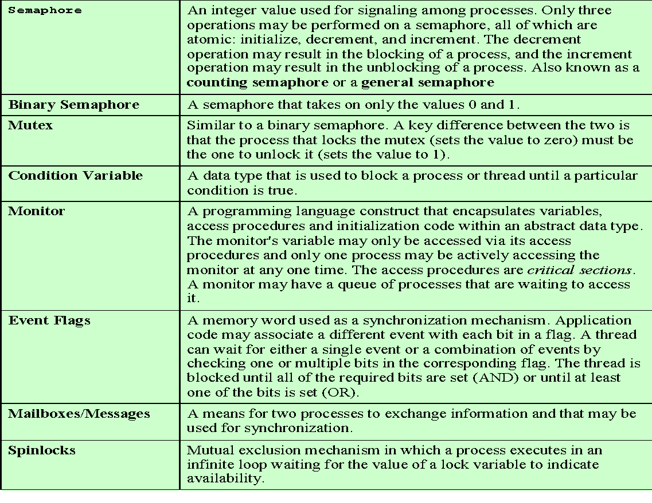

Common Concurrency Mechanisms
Notes:
We now turn to OS and programming language mechanisms that are used to provide concurrency. Table 5.3 summarizes mechanisms in common use. We begin, in this section, with semaphores. The next two sections discuss monitors and message passing.
98

Slide 99
Motivation for Semaphores
Locks only provide mutual exclusion
Ensure only one thread is in critical section at a time
May want more: Place ordering on scheduling of threads
Example: Producer/Consumer
Producer: Creates a resource (data)
Consumer: Uses a resource (data)
Example
- ps | grep “gcc” | wc
Don’t want producers and consumers to operate in lock step
Place a fixed-size buffer between producers and consumers
Synchronize accesses to buffer
Producer waits if buffer full; consumer waits if buffer empty
Notes:
99
99
99

Slide 100
Semaphore
Semaphores: Introduced by Dijkstra in 1960s
Principle: Two or more processes can cooperate by means of simple signal.
Semaphores have two purposes
Mutex: Ensure threads don’t access critical section at same time
Scheduling constraints: Ensure threads execute in specific order
Notes:
100
100
100

Slide 101
Semaphore Operations
Initialization: Initialize a value atomically
P (or Down or Wait) definition :
Atomic operation
Wait for semaphore to become positive and then decrement
P(s){
while (s <= 0)
;
s--;
}
V (or Up or Signal) definition :
Atomic operation
Increment semaphore by 1
V(s){
s++;
}
Notes:
101
101
101

Slide 102
Semaphore as General Synchronization Tool
Counting/general semaphore – integer value can range over an unrestricted domain
Binary semaphore – integer value can be either 0 or 1; can be simpler to implement
Also known as mutex locks
Can implement a counting semaphore S as a binary semaphore
Provides mutual exclusion
Semaphore S; // initialized to 1
wait (S);
Critical Section
signal (S);
Notes:
102
102
102

Slide 103
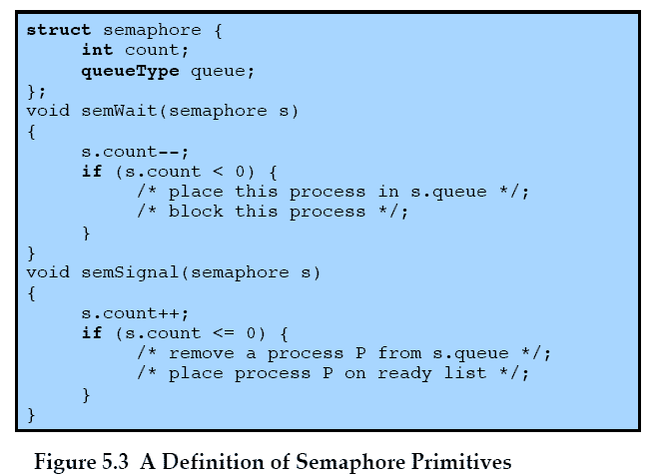
Semaphore Primitives
Notes:
103
103
103

Slide 104
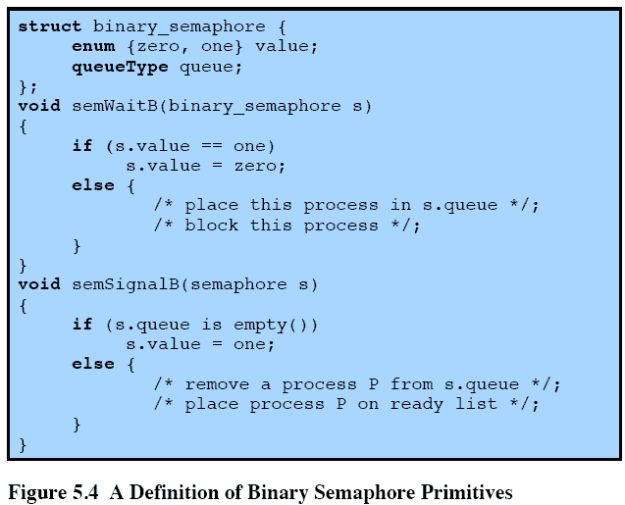
Binary Semaphore Primitives
Notes:
104
104
104

Slide 105
Binary Semaphore
A more restrictive semaphore which may only have the value of 0 or 1
A similar concept related to the binary semaphore is the mutex.
A key difference between the two is that the process that locks the mutex (sets the value to zero) must be the one to unlock it (sets the value to 1).
In contrast, it is possible for one process to lock a binary semaphore and for another to unlock it.
Notes:
105
105
105

Slide 106
Strong/Weak Semaphore
A queue is used to hold processes waiting on the semaphore
In what order are processes removed from the queue?
Strong Semaphores uses FIFO-No starvation
Strong semaphore guarantee freedom from starvation
Weak Semaphores don’t specify the order of removal from the queue
Weak semaphore do not guarantee freedom from starvation
Notes:
106
106
106

Slide 107
Mutual Exclusion using Semaphore
As the semaphore is initialized to 1, the first process executing wait will enter into its critical section and will set the value of s to 0. Any other process may attempt to enter, resulting in decrementing s to a negative value and suspension of that process. Ultimately, the process initially
entered into its critical section will depart with incrementing the value of s, resulting one of the suspended process to be released. Next a possible sequence of events for 3 processes are shown to
achieve mutual exclusion.
The following pseudo ops can be used for the mutual exclusion problem
There could be n processes
Each process executes wait before entering to its critical section
Positive value means it can enter into critical section
If the value becomes negative, process is suspended
Semaphore s = 1; n = “number of processes”;
Process ()
{
{
wait (s)
critical section
signal (s)
}
remaining execution
}
Notes:
107
107
107

Slide 108
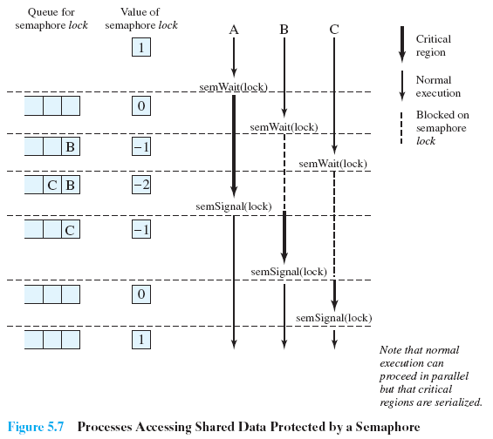
Mutual Exclusion using Semaphore
Notes:
108
108
108

Slide 109
consequences of the semaphore definition
There is no way to know before a process decrements a semaphore whether it will block or not
There is no way to know which process will continue immediately on a uniprocessor system when two processes are running concurrently
You don’t know whether another process is waiting so the number of unblocked processes may be zero or one
Notes:
[DOWN08] points out three interesting consequences of the semaphore definition:
• In general, there is no way to know before a process decrements a semaphore whether it will block or not.
After a process increments a semaphore and another process gets woken up, both processes continue running concurrently. There is no way to know which process, if either, will continue immediately on a uniprocessor system.
• When you signal a semaphore, you don’t necessarily know whether another process is waiting, so the number of unblocked processes may be zero or one.
109

Slide 110
Mutex(MUTual EXclusion locks)
These are useful to manage mutual exclusion to some shared resource
Easy & efficient to implement
It can be in one of two states: locked /unlocked
0 means unlocked & other values means locked.
Two operation: mutex_locked & mutex_unlocked
When thread needs access to CR it calls mutex_lock ()
After working with CR it calls mutex_unlock()
Example of lavatory
Process ()
{
{
mutex_lock()
critical section
mutex_unlock ()
}
remaining execution
}
Notes:
110
110
110

Slide 111
Producer/Consumer Problem
General Statement:
one or more producers are generating data and placing these in a buffer
a single consumer is taking items out of the buffer one at a time
only one producer or consumer may access the buffer at any one time
The Problem:
ensure that the producer can’t add data into full buffer and consumer can’t remove data from an empty buffer
Notes:
We now examine one of the most common problems faced in concurrent processing: the producer/consumer problem. The general statement is this: There are one or more producers generating some type of data (records, characters) and placing these in a buffer. There is a single consumer that is taking items out of the buffer one at a time. The system is to be constrained to prevent the overlap of buffer operations. That is, only one agent (producer or consumer) may access the buffer at any one time. The problem is to make sure that the producer won’t try to add data into the buffer if it’s full and that the consumer won’t try to remove data from an empty buffer. We will look at a number of solutions to this problem to illustrate both the power and the pitfalls of semaphores.
111

Slide 112
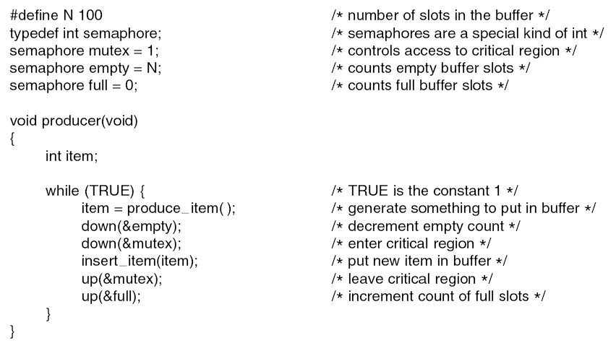
Semaphores: Producer-Consumer problem (Bounded buffer )
Notes:
112
112
112

Slide 113
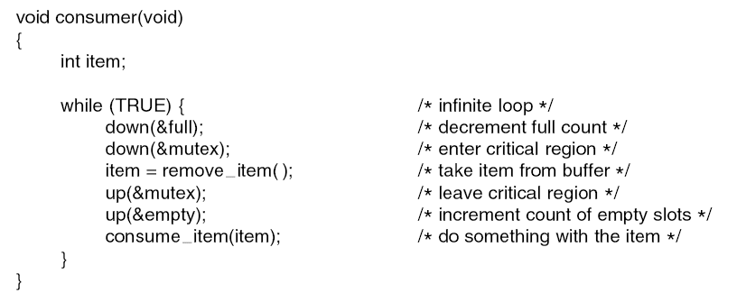
Semaphores: Producer-Consumer problem
Notes:
113
113
113

Slide 114
Readers/Writers Problem
A data area is shared among many processes
some processes only read the data area, (readers) and some only write to the data area (writers)
Conditions to satisfy:
Multiple readers may read the file at once.
Only one writer at a time may write
If a writer is writing to the file, no reader may read it.
Notes:
114
114
114

Slide 115
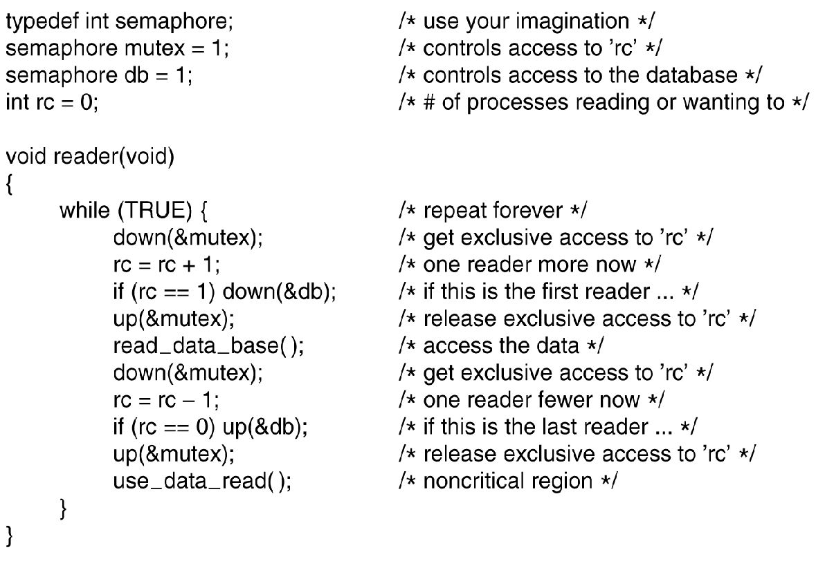
Semaphore: Reader- writer problem
Notes:
115
115
115
The readers/writers problem is defined as follows: There is a data area shared among a number of processes. The data area could be a file, a block of main memory, or even a bank of processor registers. There are a number of processes that only read the data area (readers) and a number that only write to the data area (writers). The conditions that must be satisfied are as follows:
1. Any number of readers may simultaneously read the file.
2. Only one writer at a time may write to the file.
3. If a writer is writing to the file, no reader may read it.
Thus, readers are processes that are not required to exclude one another and writers are processes that are required to exclude all other processes, readers and writers alike.

Slide 116
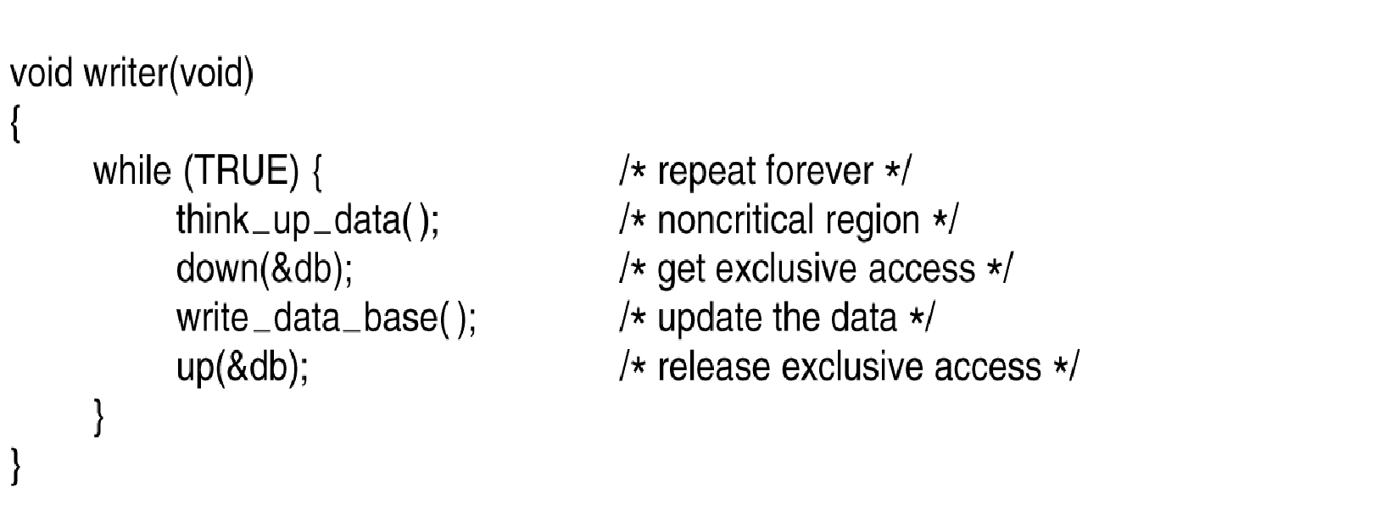
Semaphore: Reader- writer problem
Notes:
116
116
116

Slide 117

Dining philosopher problem
Situation:
Five philosophers at table
Want to eat spaghetti
Must have 2 forks to eat
Only 5 forks at the table
Each philosopher:
Must grab fork one at a
time
Can act at any time
(concurrently with other
philosophers)
Is either thinking, hungry, or eating
Notes:
117
117
117

Slide 118
Dining philosopher problem
Everyone follows:
Grab left fork
Grab right fork
Eat spaghetti
If fork not available, wait until available
Release fork when done eating
What if all grab left fork at same time?
DEADLOCK
Notes:
118
118
118

Slide 119
Dining philosopher problem
One person follows:
Grab right fork
Grab left fork
Eat spaghetti
Everyone else follows:
Grab left fork
Grab right fork
Eat spaghetti
Avoids deadlock!
Notes:
119
119
119

Slide 120
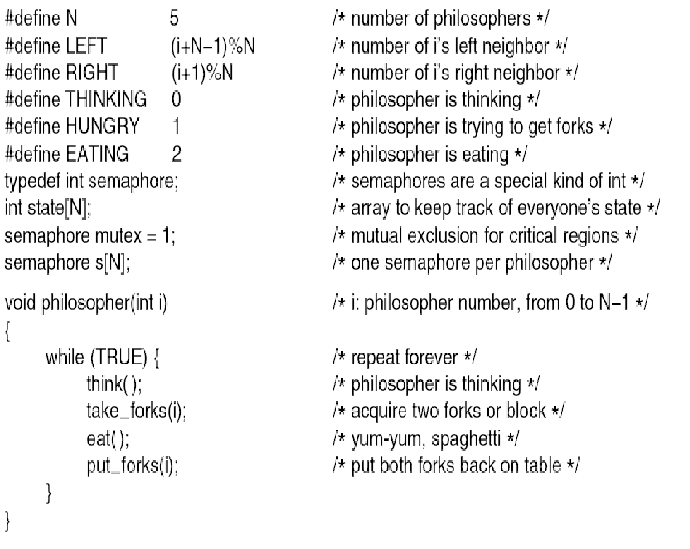
Semaphore: Dining philosopher problem
Notes:
120
120
120

Slide 121
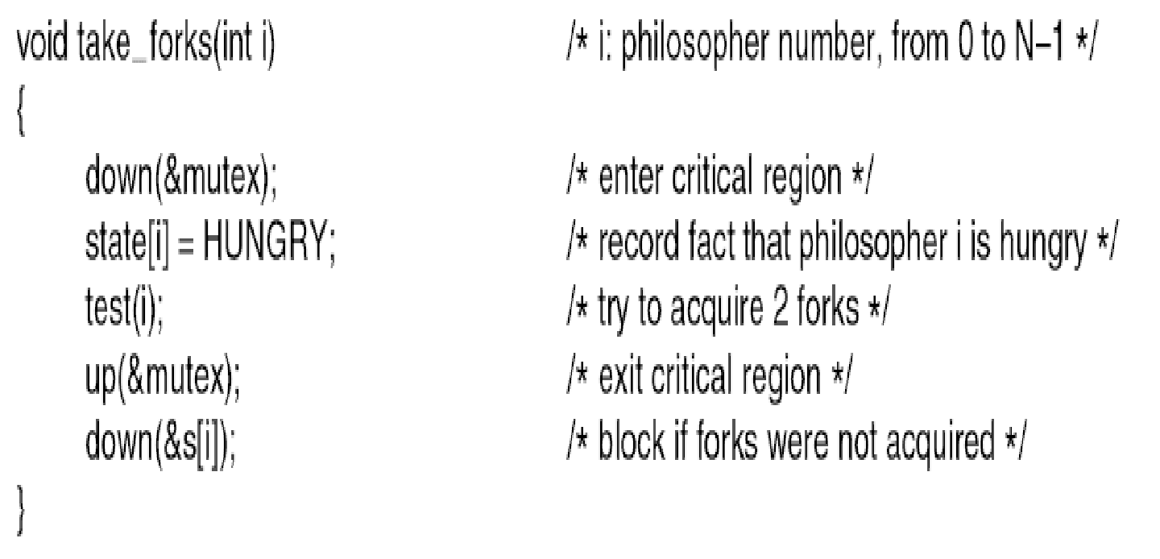
Semaphore: Dining philosopher problem
Notes:
121
121
121

